Slide 1
Machine Learning for Probabilistic Robotics with Webots
Joan Gerard

Slide 2
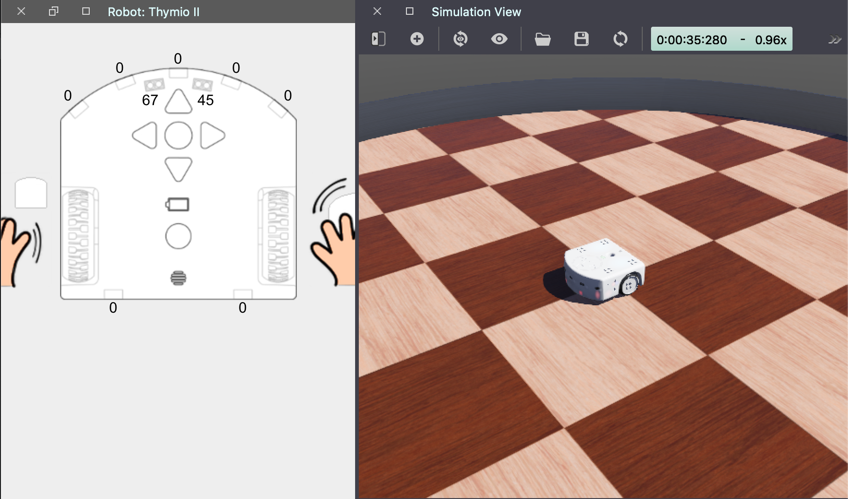
Webots R2019b new features
HTML controller plugins: Webots API: wb_robot_wwi_receive_text wb_robot_wwi_send_text
Web Streaming Server

Slide 3
Web Streaming Server

Slide 4


Online learning with Creme + Keras
Creme a library for online machine learning with python
Keras is a high-level neural networks API
Together can be combined to do online learning: a model that learns one observation at a time.

Slide 5
What can we do with both?
Make it easy to use RNN and CNN.
They allow to work with pre-trained neural networks and forward propagate to a pre-specified layer.
This allows to do transfer learning and to train just a specific layer using new incoming data.

Slide 6
Big picture: RNN
RNNs are fed with data then outputs a result back into themselves. They are smart at remembering things that have happened in the past.

Slide 7
Project Goals Proposition
Take two environments: simple, and complex.
Apply ML with probabilistic techniques to estimate the robot position in the small and complex environment: planning to use RNN and particles filter.
Use online learning to train the robot in the small and complex environment.
Study and apply transfer learning techniques: use another robot and see if it can learn from the pre-built dataset to predict its position in the simple and complex environment
Capture sensor data and robot coordinates for an e-puck in both environments.
Compare results and put them in the Webots webserver.

